Slide 1
FORECAST THE TOTAL AMOUNT OF PRODUCTS SOLD IN EVERY SHOP

Slide 2
Project Overview:
Sales are the lifeblood of a business. Sales forecasting is a crucial part of the financial planning of a business & is a self-assessment tool that uses past and current sales statistics to intelligently predict future performance.
The project involves predicting the sales of total amount of products sold in each shop
The Forecasting is conducted by using machine learning techniques like ARIMA, Multiple Linear Regression, and FB Prophet Forecasting

Slide 3
Objectives of the project:
The Primary objectives of the study are:
• Study the sales of various items across different stores of Russia in a given interval and forecast the sales.
• Identify the various factors that affect the sales of items across stores.
• Explore the possibility of developing a Time Series ARIMA model to forecast sales.
• Performing a Multiple Linear Regression, FB Prophet Forecasting and compare it with the ARIMA Model

Slide 4
High level project milestones:
Understand the Domain, Identify business problem
Data Collection
Data Cleaning, Preparation
Data reduction and transformation
Develop Model
Validate Model
Assessment and Review with stakeholders

Slide 5
About the dataset:
Accurate data collection is essential to maintaining the integrity of research, making informed business decisions and ensuring quality assurance. Hence, we chose dataset consisting of daily sales data, provided by one of the largest Russian software firms - 1C Company.
There are 3000000 observations and 11 attributes. The dataset contains daily sales of 22170 different items in different 60 shops of Russia in the interval of January 2013 to October 2015.

Slide 6
Dataset Features:
ID - an Id that represents a (Shop, Item) tuple within the test set
shop_id - unique identifier of a shop
item_id - unique identifier of a product
item_category_id - unique identifier of item category
item_cnt_day - number of products sold. You are predicting a monthly amount of this measure
item_price - current price of an item
date - date in format dd/mm/yyyy
date_block_num - a consecutive month number, used for convenience. January 2013 is 0, February 2013 is 1,..., October 2015 is 33
item_name - name of item
shop_name - name of shop
item_category_name - name of item category

Slide 7
Broad approach to data Pre-processing:
Data Cleaning
Data Integration
Data Reduction
Data Transformation
Data cleansing or data cleaning is the process of detecting and correcting (or removing) corrupt or inaccurate records from a dataset. After analysing we came to know there are no missing, corrupt or inaccurate records in the dataset.
We had combined sales test and train data with items, item categories, shops to obtain a clear information about the sales of products.
The basic concept is the reduction of multitudinous amounts of data down to the meaningful parts. Since we had sales information about 60 stores, we had to filter top five shops based on sales.
Derived features are usually obtained from feature engineering, where we extract features from existing data attributes. We derived certain features from the date column for analysis

Slide 8
Derived features:
Name of the week day i.e., Sunday, Monday…
Day number of the weekday i.e., 0 for Monday, 1 for Tuesday…
Whether day is weekday or weekend i.e., Saturday and Sunday are weekend else Week day
Day is holiday or not i.e., Dates which had Russian National Holidays
Festival day or not i.e., Dates which had Russian Festivals
Season of the current date i.e., Winter, Summer, Autumn, Spring

Slide 9
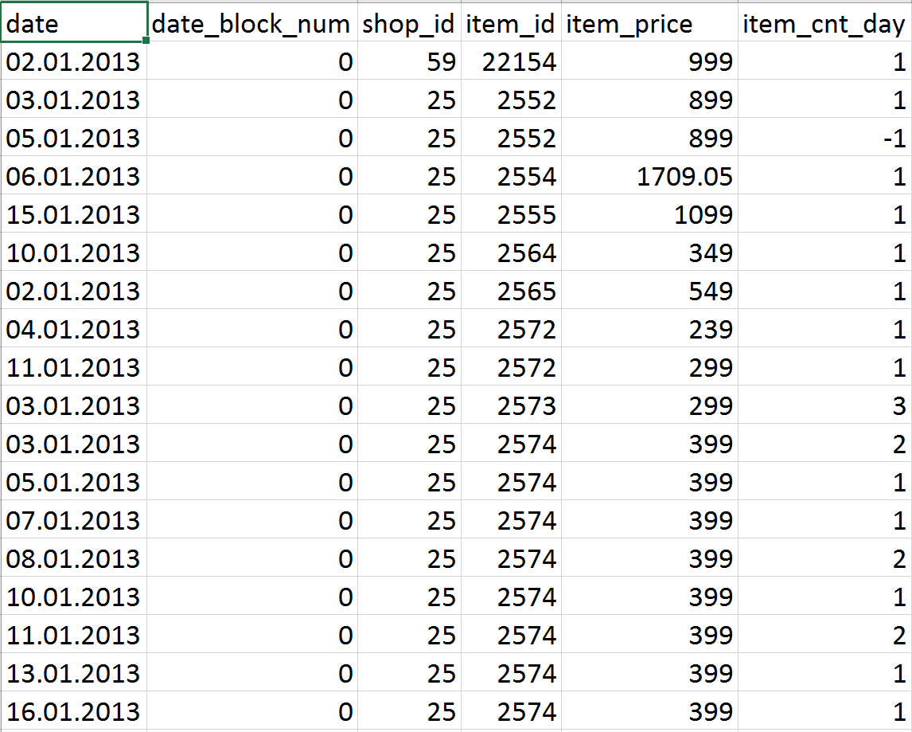
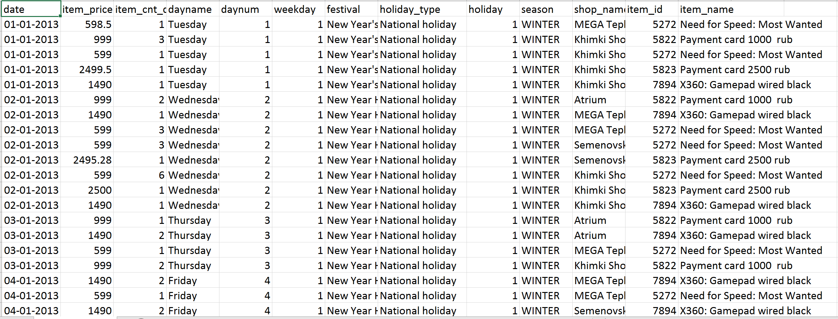
Dataset:

Slide 10
Exploratory Data Analysis

Slide 11
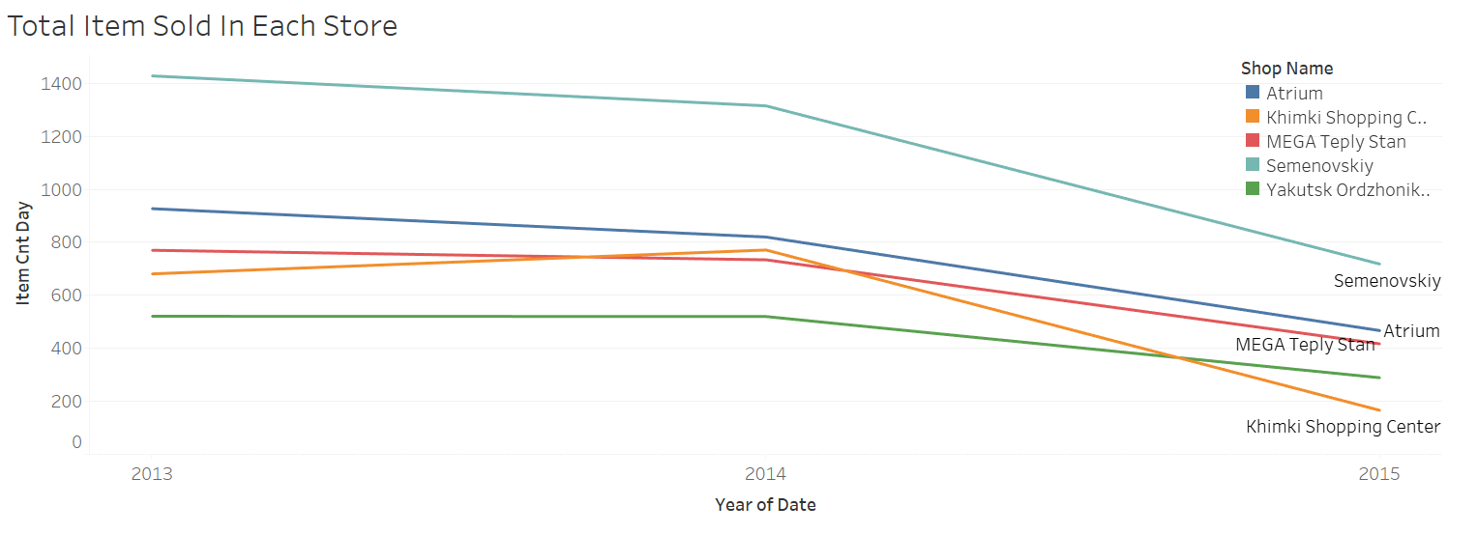
ANALYSING THE TOTAL NUMBER OF ITEMS SOLD IN EACH STORE:
In all the five stores the sale is dropping from 2013 to 2015
The sales of Semenovskiy and Khimki shopping centre were drastically decreasing from 2014 to 2015
Total number of items sold Semenovskiy is higher than all other stores in the time interval from 2013 to 2015
Yakustsk store has the least number of items sold in the time interval from 2013 to 2015

Slide 12
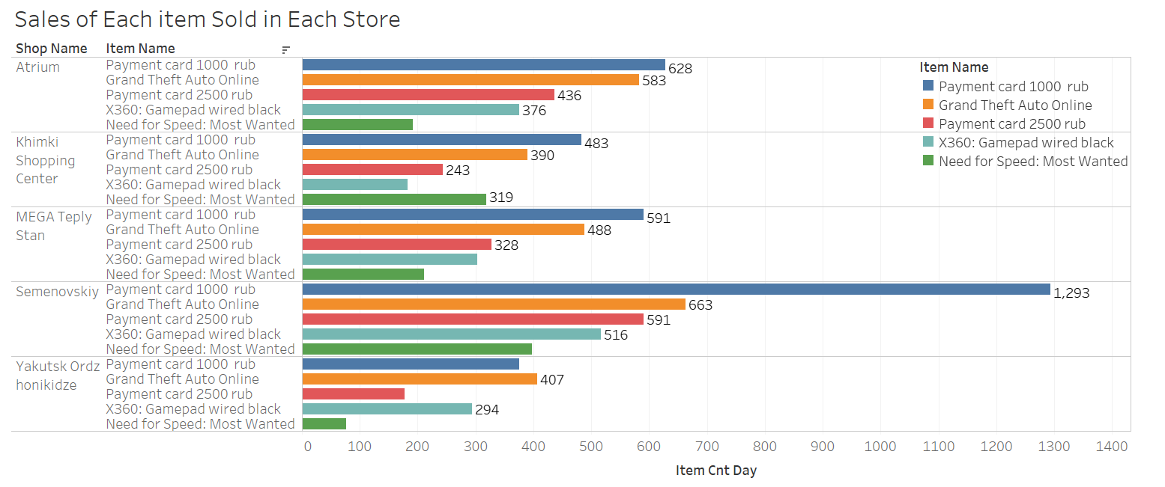
ANALYSING THE SALE OF INDIVIDUAL ITEMS IN EACH STORE:
Sales of all the 5 items high in Semenovskiy followed by Atrium
Compared to all the products ‘Payment card 1000’ had been brought most in 2014
Need for speed is the least bought game in the time interval from 2013 to 2015
Grand Theft Auto was the most popular game during the time interval 2013 to 2015

Slide 13
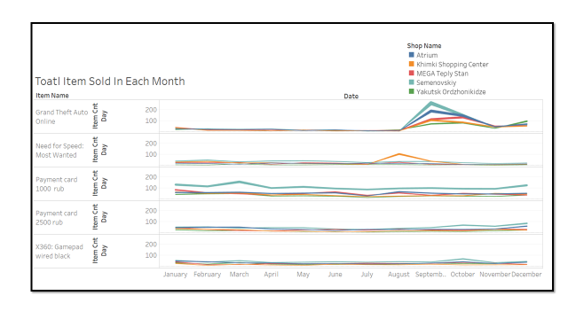
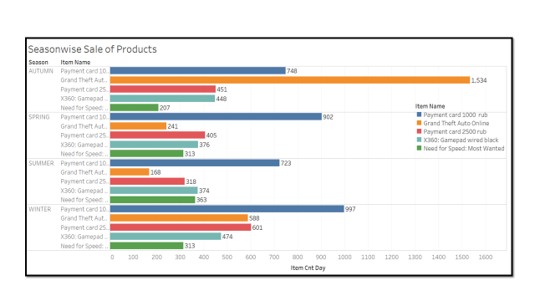
ANALYSING THE MONTHLY AND SEASONWISE SALES OF INDIVIDUAL ITEMS IN EACH STORE:
In all the three years, September has high sales and we are going deeper to understand why there is a hike in September and found out Grand Theft Auto Product was launched on 17th September 2013
Autumn (Sep-Oct-Nov) has a greater number of sales than the other seasons
GTA was sold mostly in autumn season
Sales of all the items is less in summer season

Slide 14
Statistical tools & techniques
Tools
Python
Techniques
R Programming
Tableau
ARIMA
Multiple Linear Regression
FB Prophet Forecasting

Slide 15
ARIMA:
Check for Stationarity
Plot the time series
Identification of Best fit ARIMA model
Forecast Sales using best fit Arima model
Plot ACF and PACF to identify AR and MA model

Slide 16
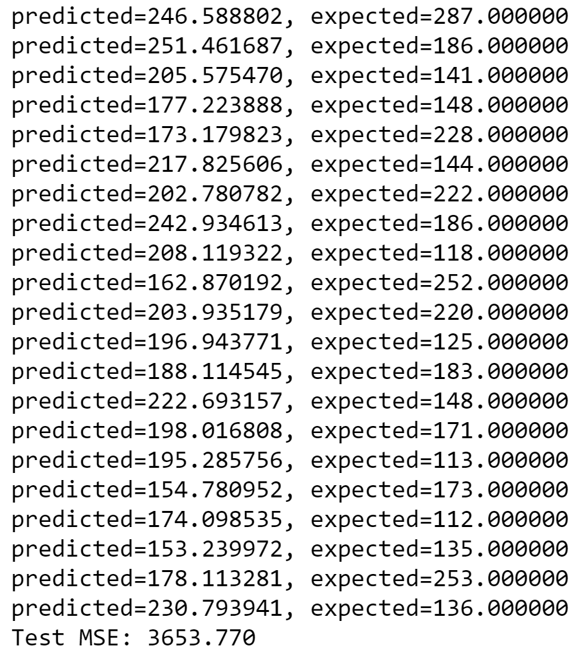
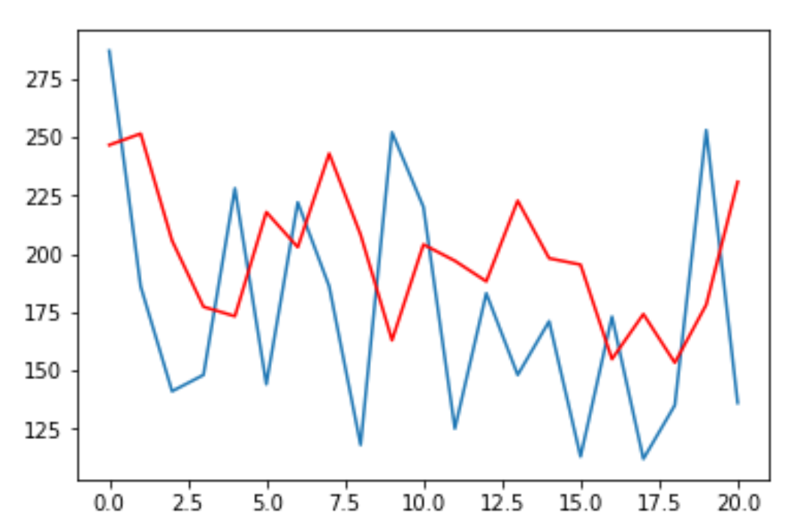
Forecast For Atrium Store

Slide 17
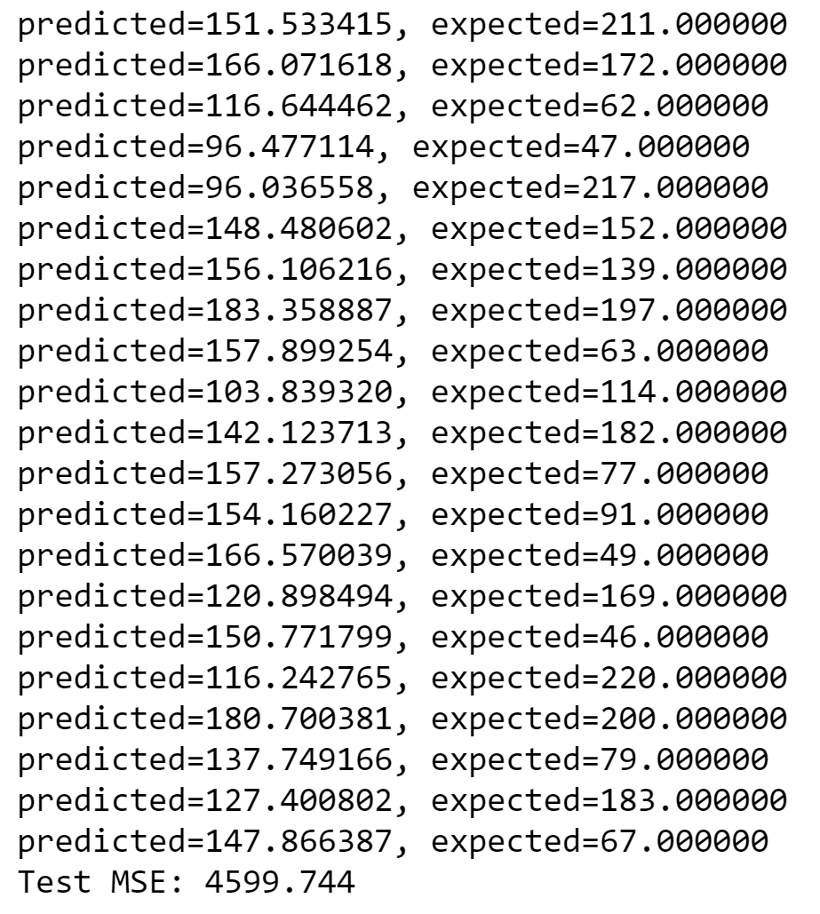
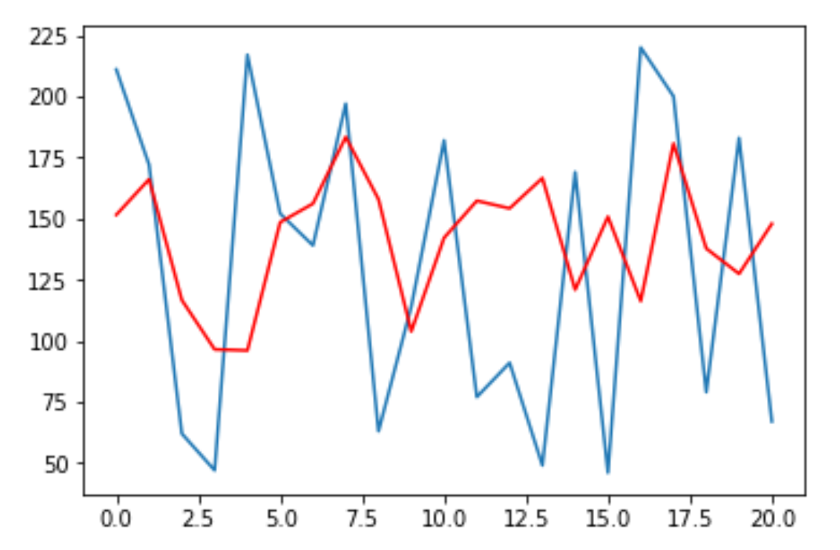
Forecast For Mega Teply Stan Store

Slide 18
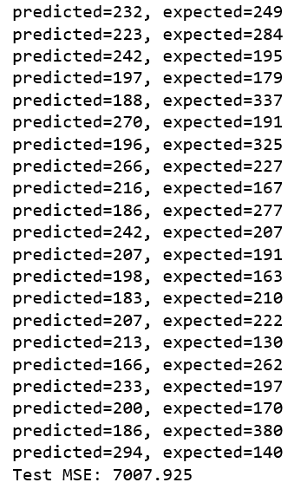
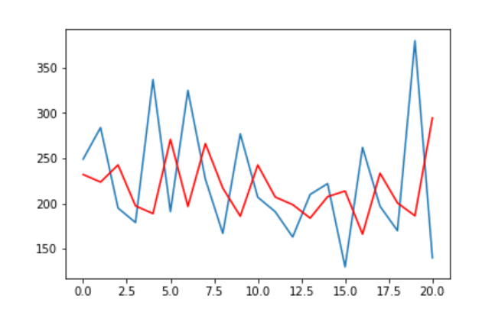
Forecast For Semenovskiy Store

Slide 19
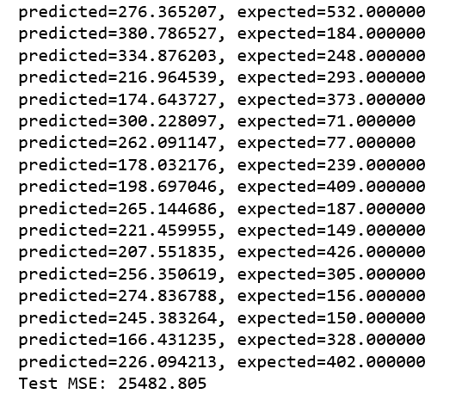
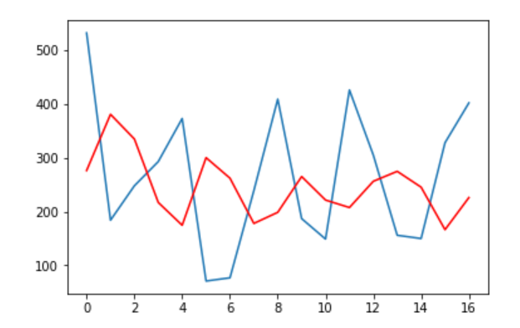
Forecast For Kimki Shopping Centre Store

Slide 20
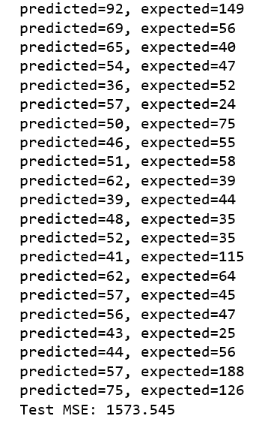
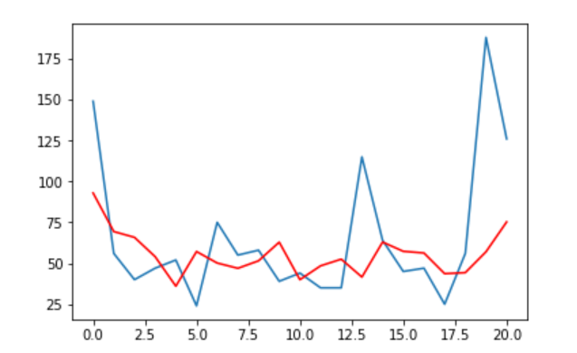
Forecast For Yakutsk Ordz Honikidze Store

Slide 21
Performance Measure For ARIMA Over Five Store
MODEL | MSE | RMSE
Atrium | 3653.770 | 60.44642
Mega Teply Stan | 4599.744 | 67.82141
Semenovisky | 7007.925 | 83.71
Khimki Shopping Centre | 25482.805 | 159.63
Yakutsk Ordz Honikidze | 1573.545 | 39.66

Slide 22
Multiple Linear Regression:
Correlation check of independent variables
Missing value and outlier treatment
Fit the model on train data
Evaluate model on test data
Train and test random classification
MODEL | R square | RMSE
MLR | 77% | 441.91

Slide 23
FB Prophet:
A yearly seasonal component modelled using Fourier series
Additive Regression model
Make predictions for test set
Evaluate Model Performance
A weekly seasonal component using dummy variables.
MODEL | ME | RMSE | MAE | ACF
FB Prophet Forecasting | -0.007 | 98.20 | 66.88 | 0.37

Slide 24
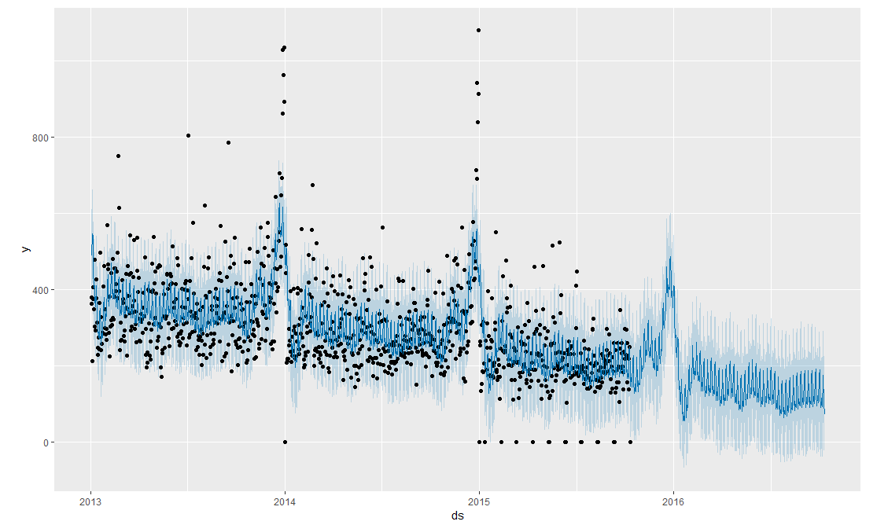
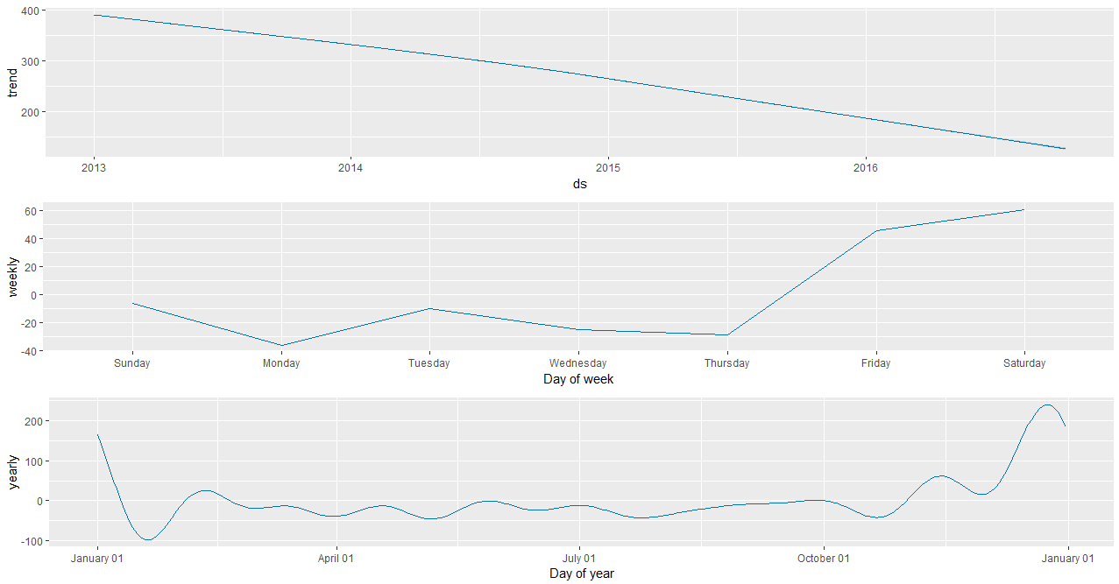
Forecasting

Slide 25
Comparison of model performance measures:
MODEL | MSE | RMSE
Atrium | 3653.770 | 60.44642
Mega Teply Stan | 4599.744 | 67.82141
Semenovisky | 7007.925 | 83.71
Khimki Shopping Centre | 25482.805 | 159.63
Yakutsk Ordz Honikidze | 1573.545 | 39.66
MODEL | R square | RMSE
MLR | 77% | 441.91
MODEL | ME | RMSE | MAE | ACF
FB Prophet Forecasting | -0.007 | 98.20 | 66.88 | 0.37

Slide 26
Final recommendation on model selection:
Since both ARIMA and Multiple Linear Regression gave good results on Comparison, we suggest that to use ARIMA for forecasting the Sales since it is estimated with maximum likelihood
On a high level MLR Can also be used for forecasting with added features

Slide 27
Actionable insights:
Sales Planning – With the help of this forecasting we can do sales planning
Demand Forecasting - to gather information about anticipated demand
Inventory Controls - to manage its inventory, avoiding both overstock and stock-out situations.
Supply Chain Management - to have better control over your supply chain
Financial Planning - the ability to explore possibilities to increase both revenue and net income.
Internal Controls - the projected sales for the business makes it possible to have better control of internal operations.
Continuous Improvement - forecasting sales and continually revising the process to improve the accuracy, you can improve all aspects of your business performance.
Marketing - an advanced look at future sales offers the opportunity to schedule promotions if it appears sales will be weak. In extreme cases, sales forecasts may lead to discontinuing slow-moving products.

Slide 28
Key Learnings:
Importance of sales forecasting
Understanding of Business Goals
Use of Relevant Data
Feature engineering
Collaboration

Slide 29


